Slide 1



Slide 3
Announcement
Attendance link will be shared in between the session or at the end of the session
Minimum 25 Days Attendance required to receive your FREE E-CERTIFICATE (with same mobile number & email id)

Slide 4
Prerequisites for this Course
Be ready with Sufficient Data
Laptop with Good Internet
No basic knowledge is required.
Note & Pen

Slide 5

Heart Disease Prediction
Heart disease prediction involves using machine learning algorithms to analyze health-related data, such as age, blood pressure, cholesterol levels, and heart rate, to predict the likelihood of an individual developing heart disease.
The goal is to create a model that can assist healthcare professionals in identifying potential risks and taking preventive measures.
This process includes collecting and cleaning data, selecting relevant features, training a machine learning model, evaluating its performance, and deploying it for predictions.

Slide 6


Basic Steps to Create a Model
Data Collection
Data Pre-Processing
Choosing a Concept
Model Training
Model Evaluation
Parameter tuning(optional)
Model prediction

Slide 7
Ready For Hands On

Slide 8


Machine Learning
Heart Disease Prediction

Slide 9


Solution - Internship
30 Day Recorded Video Lectures
(₹4000)
20+ Projects
(₹30,000)
Bonus Task, Assignments
(₹1,500)
Technical Material(PPT, Mindmap)
(₹1,000)
Rs.40,000
200 AI Interview Questions
(1500)
Rs.1,999
Certificate For Internship with your Photocopy
(₹2,000)
Daily Live Q&A Session
Lifetime Course Validity

Slide 10
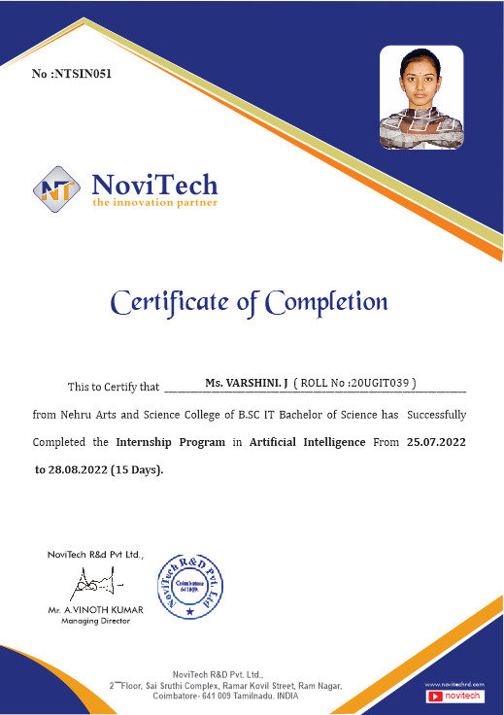

Slide 11
Mindset of the Day
The whole secret of a successful life is to find out what is one's destiny to do, and then do it.…

Slide 12

Post Your Attendance

Slide 13




THANK YOU☺
Join our What’s app Community group
novitechresearchanddevelopment

Slide 14
Q & A Session?

